Slide 1





Minor Project
Zip Guard
Presented by:
R2142220538 - Kavya Singh R2142220483 - Dhruv Joshi R2142220265 -Madhav Madan R2142220306 - Akshat Pandey
Mentored By - Dr. Arjun Arora

Slide 2




Introduction
Protection and management of data.
File compression and encryption/decryption features.
Zip and unzip files using Huffman coding.
Encryption and decryption using AES/RSA/Huffman coding algorithms.
Autogenerated Key for encrypting and decrypting data.
Data Security Challenges
Unauthorized access and data breaches are growing concerns along with the amount of digital information.
Traditional file compression and encryption techniques may be too complicated or challenging.

Slide 3


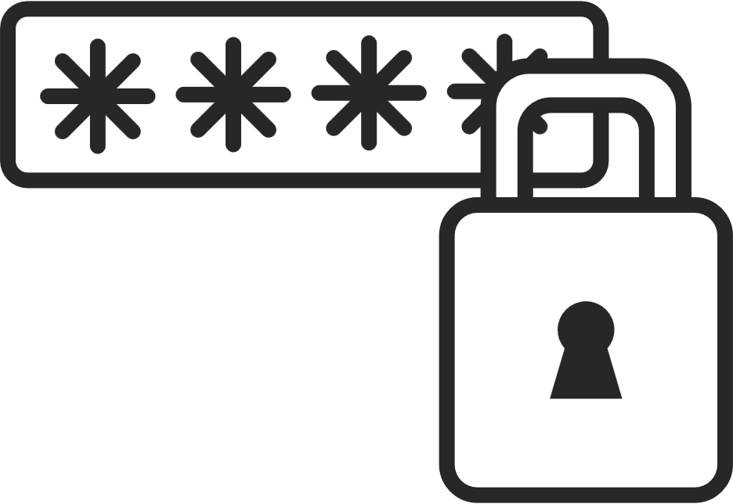
Problem Statement
In today's digital world, secure and effective data management is essential. Many consumers find that the security and usability of existing solutions are compromised, leaving their sensitive data poorly protected. With an emphasis on user choice and convenience, "Zip Guard" aims to address this issue by offering an efficient solution that combines file compression with encryption.

Slide 4


Objectives
Develop a tool that uses Huffman coding to compress and encrypt files efficiently.
Provide users an option to choose between algorithms and use their preffered ones.
Automate these processes to make it easy for users to utilize services even without technical background.
Integrate encryption, decryption, compression, and decompression functionalities into a single, cohesive package, providing a streamlined solution for users.

Slide 5
Overview
Zip Guard is a Core Java-based project designed to provide secure and efficient file management by combining file compression and encryption. The project allows users to compress and decompress files using Huffman coding and offers encryption options using either RSA or AES algorithms. Huffman coding ensures efficient compression, while RSA and AES offer arobust encryption to protect user data. With automated key generation, Zip Guard simplifies data security for users with minimal technical knowledge, ensuring their sensitive files are both compressed and encrypted securely.

Slide 6
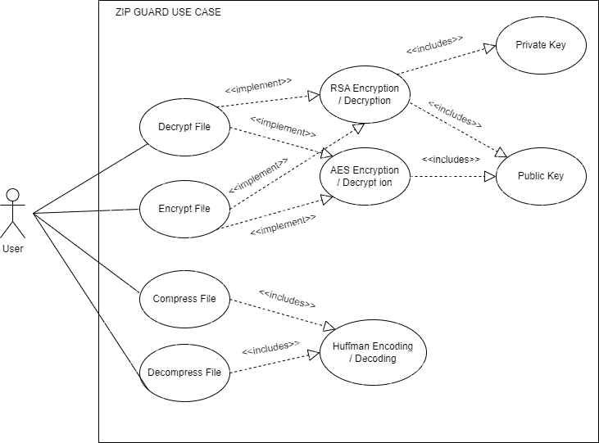
Use Case Diagram

Slide 7
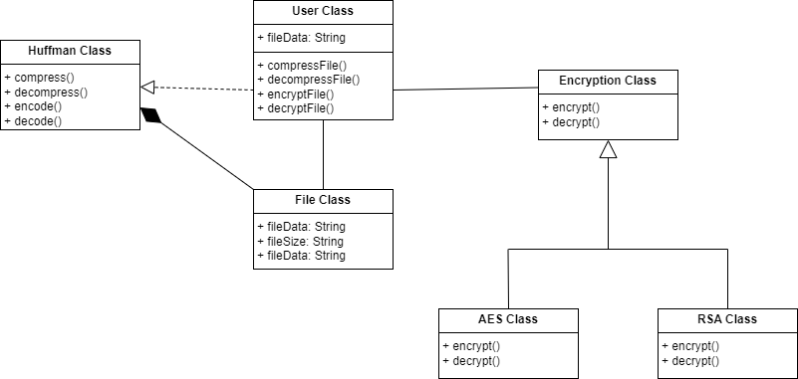
Class Diagram

Slide 8

About RSA Algorithm
RSA stands for Rivest-Shamir-Adleman
It is an asymmetric cryptography algorithm
It works on two different keys i.e. Public Key and Private Key
Public Key is given to everyone and the Private key is kept private
It is widely used to secure sensitive data, particularly when it is being sent over an insecure network such as the internet

Slide 9
RSA Working
Generates a key pair object which contains public and private key
Takes input of the file path
Returns byte array of file
Encrypt the file data by converting it into cipher text and using public key
For decryption you need to provide the private key to decrypt that file

Slide 10
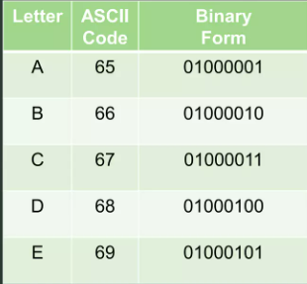

Introduction to Huffman Coding
Huffman Coding is a famous Greedy Algorithm used for lossless data compression
The most frequent character gets the smallest code and the least frequent character gets the largest code.
75% compression ⇒ ¼ original size
Prefix Rule: Ensures that no code is a prefix of any other code, preventing ambiguities during decoding.
Message: BCCABBDDAECCBBAEDDCC
Length=20
For 1 Latter we need 8bits so for 20 latter 8*20=160 bits

Slide 11

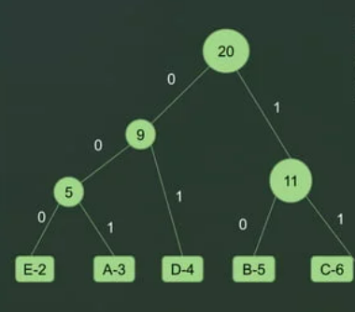
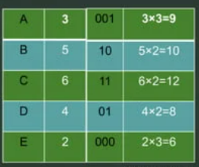
Message: BCCABBDDAECCBBAEDDCC
As we see first we do need 160 bits and now we need 45bits now we have compressed the cost and size
Time complexity of the Huffman Coding is O(nlogn),where n is the number of unique characters.

Slide 12

AES
AES is a symmetric key block cipher, meaning it uses the same key for both encryption and decryption.
AES supports three key lengths—128, 192, and 256 bits—each offering a different level of security.
The AES algorithm applies multiple rounds of transformation (10, 12, or 14 rounds depending on key length), involving substitution, permutation, and mixing of the data to provide robust encryption.

Slide 13

Thank You

